Slide 1

Project Bellabeat How can we make the best marketing campaign using data?
By Marcos López

Slide 2

Index
Introduction
Ask
Prepare
Clean and Process
Analyze
Share
Act

Slide 3
Introduction
For this project I will take the role of a data analyst jr at Bellabeat., a high-tech manufacturer of health-focused products for women, and meet different characters and team members. In order to answer the key business questions, I will follow the steps of the data analysis process: ask, prepare, process, analyze, share, and act.
The data will be cleaned and analyzed using SQL and Tableau.

Slide 4
ASK
I have been asked to focus on one of Bellabeat’s products and analyze smart device data to gain insight into how consumers are using their smart devices. The insights you discover will then help guide marketing strategy for the company.
The key question we must ask ourselves is:
What data can we extract to carry out the marketing strategy?

Slide 5
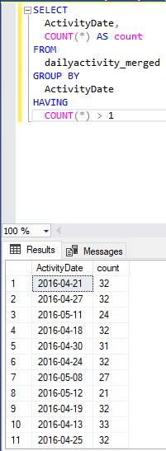
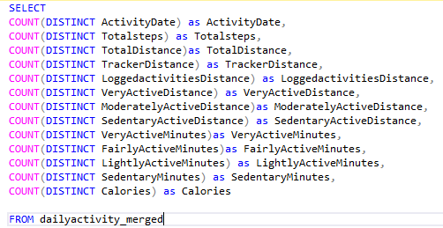
PREPARE
In this stage I will load all the information in tables inside a database in Microsoft SQL Server. I will also check for duplicates and filter out NULL data.
The query on the left lets me know how many unique values ​​there are per column. The one on the right lets me know how many values ​​were repeated.
These queries were made to detect which duplicate values ​​existed and if they should be deleted or not. However, analyzing column by column, duplicate data does not impair the analysis.

Slide 6
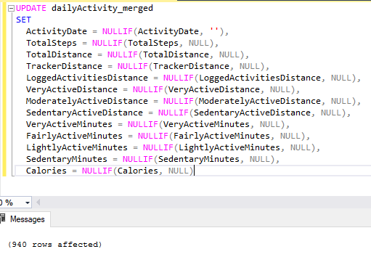
This query allows me to update the "dailyActivity_merged" table by removing all NULL data from it.

Slide 7
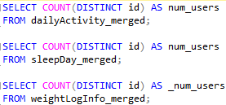
ANALYZE
At this stage we will answer a series of questions to know the profile of the clients. But first we must answer the following basic questions:
How many unique user Ids are in each table?
This query gives us as a result that the first table has 33 users. The second 24 and the third 8.

Slide 8
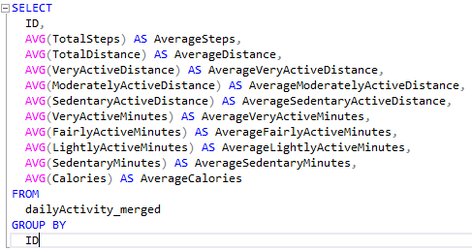
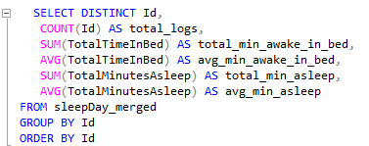
How much activity are users performing on average?
This query resulted in:
7 people taking more than 10,000 steps.
18 people made between less than 10,000 steps and 5000.
8 people less than 5000 steps.
This query gave us the following results:
Only 3 users tracked their sleep for the full month.
15 of the 24 did complete at least half of the month at 15 daily logs or more
12 got at least 7 hours of sleep. The other 12 got less than 7 hours.
Most users have time disrupted from sleep, 19 of the 24 had more than 15 minutes of being awake during their sleep cycle
How much sleep do users get on average?

Slide 9
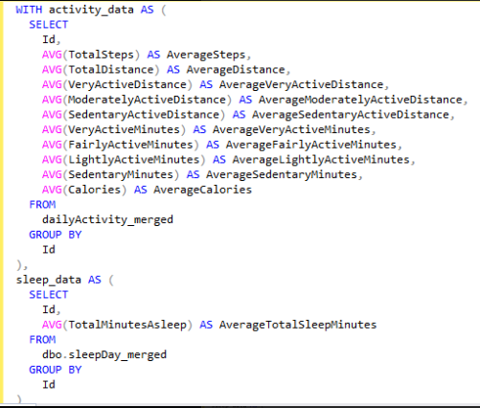
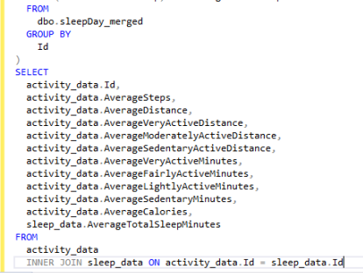
Combine the sleep and activity data grouped by Id into one table

Slide 10
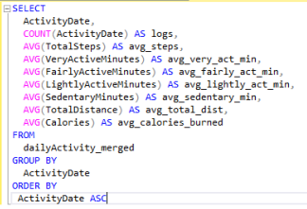
What days do the most and least activity take place on?
This query allows us to answer this question and analyze other data. The answer to the question is that the busiest days are Tuesday and Wednesday, and the day with the least activity is Sunday.
We can also notice that after a month, the clients that continue with their activity are reduced from 33 to 21.
The amount of calories burned is consistently around 2300 kcal a day.

Slide 11
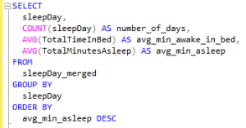
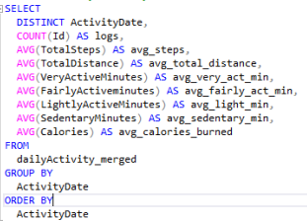
What days do users have the most and least sleep?
Users get the most sleep and the recommended at least 7 hours on Sundays, Wednesdays, and Saturdays. The rest of the week users get 6.7-6.9 hours of sleep.
The more sleep users get the greater amount of time they spend in bed awake throughout the week with Sundays having an average 50 minutes of restless sleep.
Are there any activity trends over time?
Users gradually stopped logging activity data over the month with the largest decline occurring from may 8 - 12th 27 users to 21 users.
Users had at least 7,000 steps on 27 of the 31 days and less than 7,000 on only 4 days.

Slide 12

How do number of steps vary by day?
Tuesday has the highest step count.
However, on average the day with the most steps per user is Saturday.
The last one is Sunday, both in total and on average.
With these SQL queries we were able to extract a lot of useful information that will help us for the conclusion.
We continue with the visualization

Slide 13
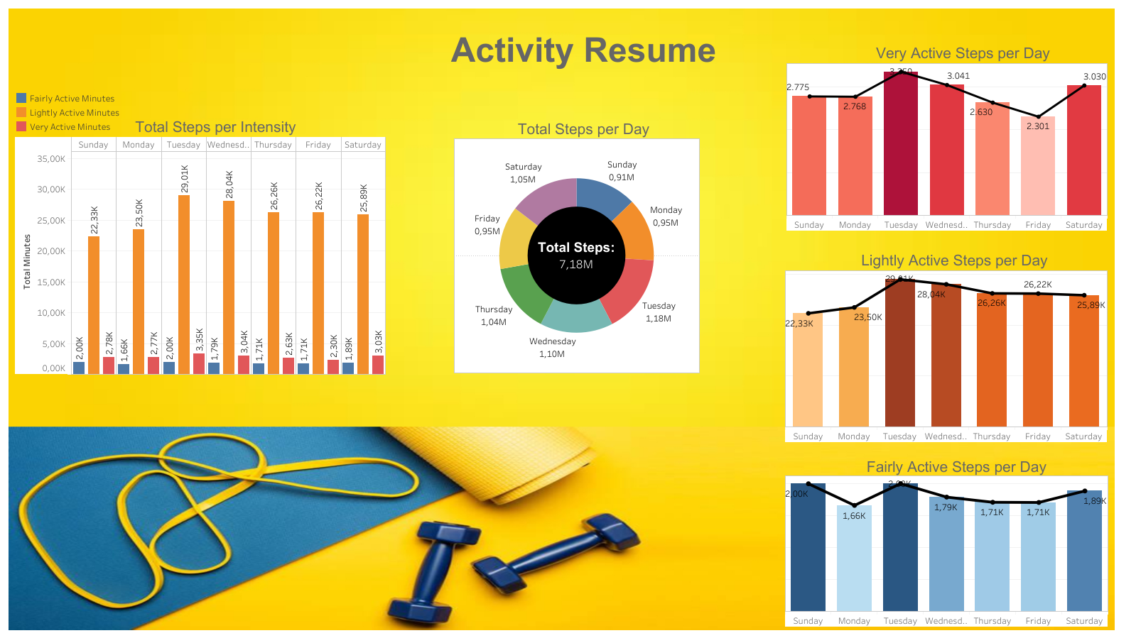

Slide 14
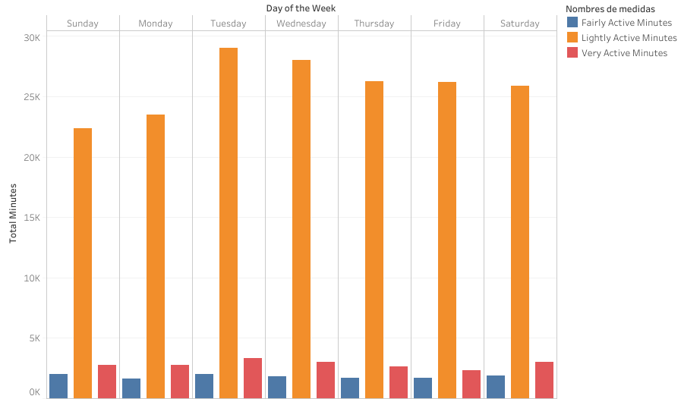

Slide 15
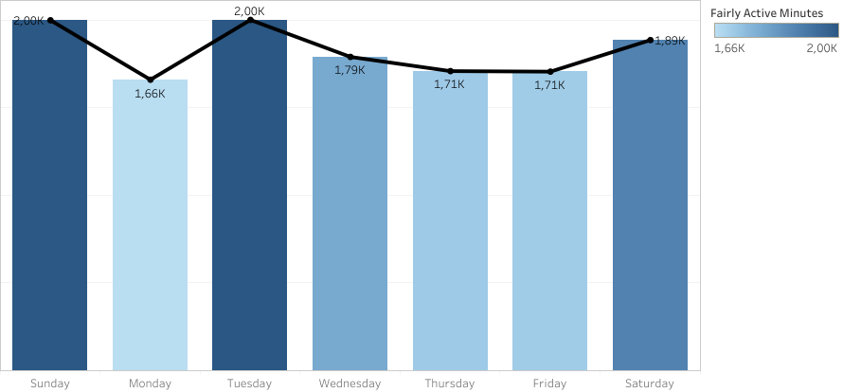

Slide 16
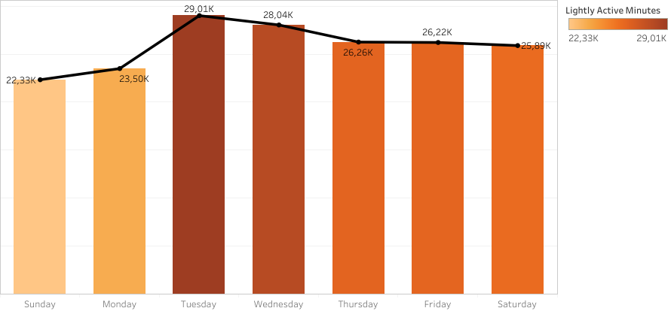

Slide 17
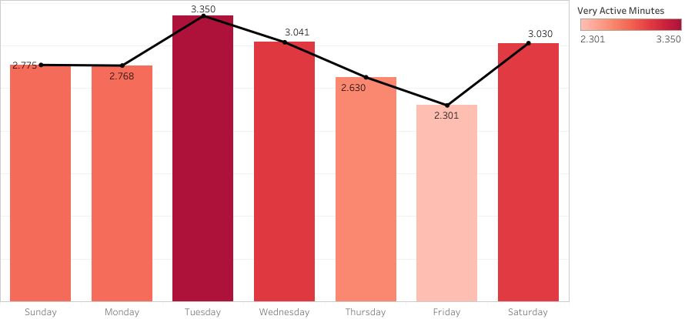

Slide 18
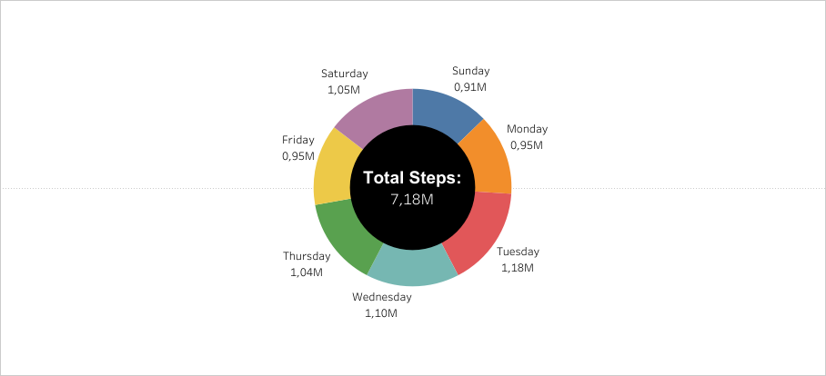

Slide 19
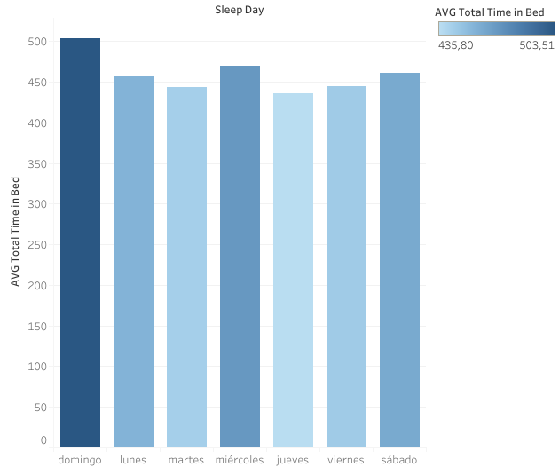
Sunday stands out as the day where users spend the most time in bed on average.

Slide 20
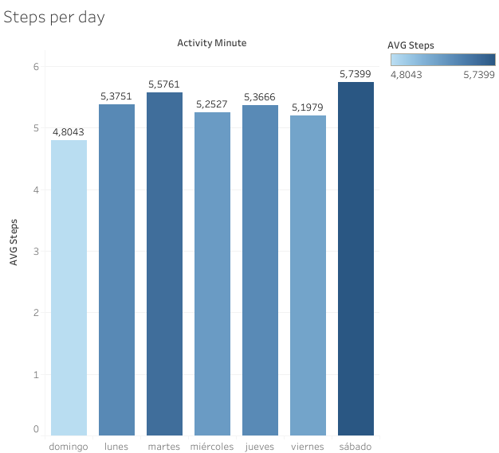
The day with the most steps on average is Saturday, but Monday and Tuesday also stand out.

Slide 21
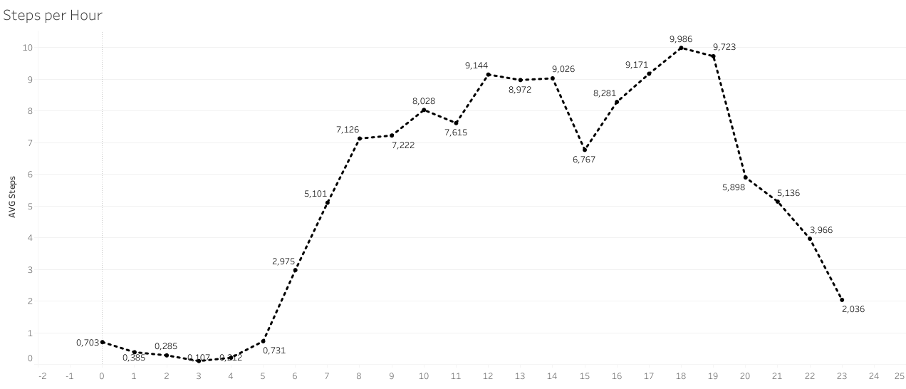
We can notice that from 3 to 7 p.m. there is a sharp increase in the total step count, with between 5 and 7 p.m. being the time of day where the most steps are taken.

Slide 22
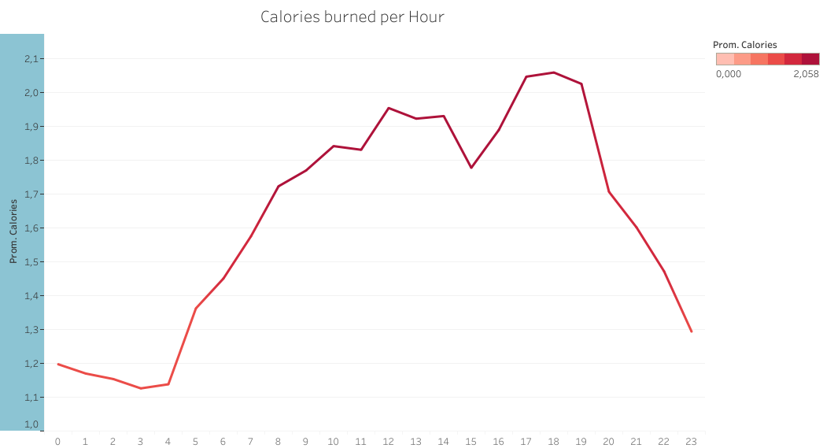
As in the previous slide we can notice a similar trend in terms of average calorie consumption.

Slide 23
If you are interested in seeing the visualizations in more detail you can enter the following links:
Dashboard Activity Resumen:
https://public.tableau.com/app/profile/marcos.lopez8357/viz/Activity_16941361272930/Hoja5#1
Calories Burned per Minute:
https://public.tableau.com/app/profile/marcos.lopez8357/viz/Caloriesburnedperminute/Sheet1#1
Total Time In Bed:
https://public.tableau.com/app/profile/marcos.lopez8357/viz/TotalTimeinBed/Sheet1#1
Steps per Time:
https://public.tableau.com/app/profile/marcos.lopez8357/viz/StepsperTime/Sheet1

Slide 24
ACT
At this stage, after analyzing the data we can deduce the following key points for the development of a marketing strategy:
The number of people interested in weight compared to those interested in sleeping or walking is significantly lower.
Most users make between 5,000 and 10,000 a day.
Most users have trouble staying asleep in their sleep cycle.
After the first month the number of active users reduces significantly.
Although Monday to Friday is when most physical activity is carried out, there is also a lot of activity on Saturday.
The times of greatest physical activity are between 5 and 7 p.m. Just after average work hours.

Slide 25
Conclusion
Taking into account the analysis carried out, we can make the following recommendations for the marketing strategy:
It is better to focus on light activities such as meditation, walking or running than on exercise that requires greater physical effort.
Focus on giving options to improve sleep and physical activity than on weight.
Give some reward to those users who manage to do more than 10,000 steps a day.
Look for incentives for users to register every day and especially at the end of the month.
Generate ideas for physical activities to do on the weekends, especially on Saturdays.
Encourage people to do some physical activity after work. One approach may be to offer post-work relaxation exercises.
Offer exercises and tools to improve the quality of sleep cycles

